Slide 1
NeurIPS: Machine Unlearning
Final Project Presentation
CSE 472 Machine Learning Sessional
BY:
Syed Jarullah Hisham - 1805004
Abdur Rafi - 1805008

Slide 2

Competition Link: https://www.kaggle.com/competitions/neurips-2023-machine-unlearning/overview

Slide 3
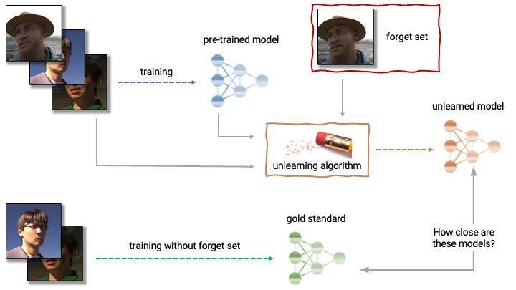
Problem Definition

Slide 4
Dataset Analysis
Competition Dataset Hidden
[retain/forget/validation].csv
- person_id: A unique ID code for each subject.
- age_group: Binned ages. The target label for the models.(15 classes)
- age - The age of the subject.
- image_id: A unique ID for the image.
images/[person_id]/[image_id].png Images of people's faces.
- If the image ID is 'abc-1' the path is images/abc/1.png.
- images have been resized to 32x32 pixels.
- Expect approximately 30,000 images in the hidden dataset.
- roughly 2% of the images in the dataset have identical perceptual hashes

Slide 5
Dataset Analysis
age_class_weights.json
- age_group weights used to train the original model
- in the form {age_group: n_occurrences}
original_model.pth
- original Resnet-18 Pytorch model checkpoint
- needs to unlearn
- 99% accuracy on the training set
- 96% accuracy on the test set
For our testing, CIFAR10 was used

Slide 6
Loss Functions
Kullback-Leibler Divergence Loss
is a way of measuring the matching between two distributions
higher the KL divergence value, the less matching of the true distribution with other
Used in Forgetting Stage
Contrastive Learning Loss
aims to pull the distance between positive samples and their enhanced samples closer and push the distance between positive samples and all samples further
pushing the distance between any forget sample and all retain samples further
Used in Adversarial Fine Tuning Stage Forget Round
Cross Entropy Loss
Used in Adversarial Fine Tuning Stage Retain Round

Slide 7
Performance Metrics
Model Quality (Cross Entropy Loss & Accuracy)
Simple Membership Inference Attack(MIA)
Combination of Forgetting Quality, Efficiency and Utility
Used in competition
Hidden metric
https://unlearning-challenge.github.io/assets/data/Machine_Unlearning_Metric.pdf

Slide 8
Approach 1 : Reproduce & Improve 1st Place Solution

Slide 9
1st Place Solution Architecture
KL-Divergence Optimization
Dataset: Forget Set
Loss Function: KL-Divergence Loss
Forgetting Stage
(1 iteration)
Original Trained Model
Round 1: Forget Round
Dataset: Both Forget & Retain Set
Loss Function: Contrastive Learning Loss
Batch Size: 256
Adversarial Fine Tuning Stage
(8 iterations)
Round 2: Retain Round
Dataset: Retain Set
Loss Function: Cross Entropy Loss
Batch Size: 256

Slide 10
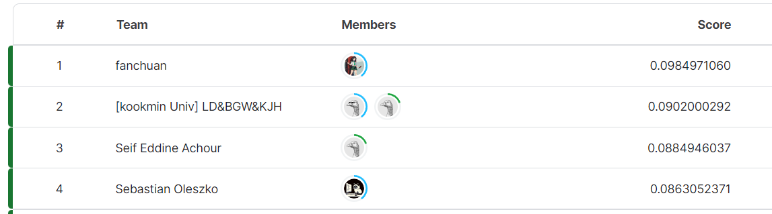
Performance Report - 1st Place
Our Reproduced Solution
Competition Leaderboard

Slide 11
Performance Report - 1st Place
Model | Dataset | Cross-Entropy Loss | Accuracy(%) | MIA Accuracy(%)
Original | Forget Set | 0.02173 | 99.32 | 57.8
 | Validation Set | 0.42808 | 88.64
Retrained | Forget Set | 0.4607 | 88.20 | 49.6
 | Retain Set | 0.0181 | 99.53
 | Validation Set | 0.4641 | 88.00
Unlearned (1st Place) | Forget Set | 0.1877 | 95.36 | 51.3
 | Retain Set | 0.0289 | 100.00
 | Validation Set | 0.3862 | 88.54

Slide 12
Performance Report - Experiments on 1st Place
Unlearned Model Modification | Dataset | Cross-Entropy Loss | Accuracy(%) | MIA Accuracy(%) | Competition Score
1st Place | Forget Set | 0.1877 | 95.36 | 51.3 | 0.09142
 | Retain Set | 0.0289 | 100.00
 | Validation Set | 0.3862 | 88.54
2 Forget Round for each epoch | Forget Set | 0.27 | 92.64 | 50.7 | 0.079052
 | Retain Set | 0.05 | 99.99
 | Validation Set | 0.38 | 88.22
9 epochs at adversarial fine tuning stage | Forget Set | 0.21 | 94.44 | 50.4 | 0.08921
 | Retain Set | 0.03 | 100.00
 | Validation Set | 0.38 | 88.34

Slide 13
Performance Report - Experiments on 1st Place
Unlearned Model Modification | Dataset | Cross-Entropy Loss | Accuracy(%) | MIA Accuracy(%) | Competition Score
10 epochs at adversarial fine tuning stage | Forget Set | 0.23 | 93.9 | 50.0 | 0.070155
 | Retain Set | 0.03 | 100.00
 | Validation Set | 0.39 | 88.32
12 epoch with 512 batch size at adversarial fine tuning stage | Forget Set | 0.31 | 90.8 | 47.0 | 0.0566
 | Retain Set | 0.03 | 100.00
 | Validation Set | 0.41 | 87.96
2 Forget Round + 9 epoch at adversarial fine tuning stage | Forget Set | 0.29 | 91.20 | 50.3 | 0.08794
 | Retain Set | 0.05 | 99.99
 | Validation Set | 0.39 | 88.26

Slide 14
Performance Report - Experiments on 1st Place
Unlearned Model Modification | Dataset | Cross-Entropy Loss | Accuracy(%) | MIA Accuracy(%) | Competition Score
JSD loss instead of KL_Div loss | Forget Set | 0.17 | 96.2 | 51.3 | 0.0273
 | Retain Set | 0.03 | 100
 | Validation Set | 0.39 | 88.42
JSD loss instead of KL_Div loss+ 2 Forget Round | Forget Set | 0.24 | 93.66 | 51.2 | 0.05621
 | Retain Set | 0.05 | 99.99
 | Validation Set | 0.38 | 88.30
Modified KL_DIV loss | Forget Set | 0.19 | 95.46 | 51.2 | 0.099985
 | Retain Set | 0.03 | 100.00
 | Validation Set | 0.39 | 88.48

Slide 15
Performance Report - Experiments on 1st Place
Unlearned Model Modification | Dataset | Cross-Entropy Loss | Accuracy(%) | MIA Accuracy(%) | Competition Score
Modified KL_DIV loss + 9 epoch | Forget Set | 0.21 | 94.74 | 50.6 | 0.09009
 | Retain Set | 0.03 | 100.00
 | Validation Set | 0.39 | 88.30
Modified kl_div + 512 batch size | Forget Set | 0.19 | 95.46 | 51.0 | 0.09838
 | Retain Set | 0.03 | 100.00
 | Validation Set | 0.39 | 88.44
Modified kl_div + 512 batch size + 9 epoch | Forget Set | 0.21 | 94.76 | 50.0 | 0.09758
 | Retain Set | 0.03 | 100.00
 | Validation Set | 0.39 | 88.28

Slide 16
Performance Report - Experiments on 1st Place
Unlearned Model Modification | Dataset | Cross-Entropy Loss | Accuracy(%) | MIA Accuracy(%) | Competition Score
Modified kl_div + relative weighting [1, 0.5] | Forget Set | 0.18 | 95.54 | 51.3 | 0.0909
 | Retain Set | 0.03 | 100.00
 | Validation Set | 0.39 | 88.42
Modified kl_div + relative weighting [1, 0.8] | Forget Set | 0.19 | 95.56 | 50.8 | 0.1003
 | Retain Set | 0.03 | 99.99
 | Validation Set | 0.39 | 88.48
Modified kl_div + relative weighting [1, 0.85] | Forget Set | 0.18 | 95.54 | 51.4 | 0.106846
 | Retain Set | 0.03 | 100.00
 | Validation Set | 0.39 | 88.60

Slide 17

Improved Solution: [Modification of KL_DIV]

Slide 18
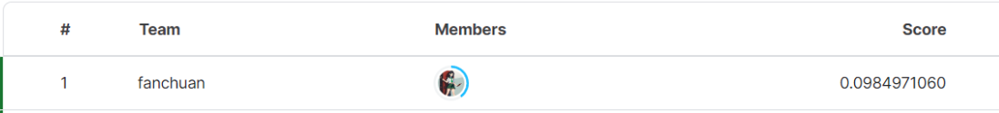
Performance Report - Successful Solution
Our Best Improved Solution
Reproduced 1st Place Solution
Competition 1st Place Solution

Slide 19
Approach 2 : Gradient Ascent Approach

Slide 20
Our Proposed Idea
2 rounds.
Forget round
Retain round

Slide 21
Our Proposed Idea-Forget Round
R: Gradient computed on sample of Retain set
F: Gradient computed on sample of Forget set
R
F_{r}
F
F_{p}
param += lr * F_{p}

Slide 22
Our Proposed Idea-Retain Round
R: Gradient computed on sample of Retain set
F: Gradient computed on sample of Forget set
R_{p}
R
F
R_{f}
param -= lr * R_{p}

Slide 23
Our Proposed Idea
Forget Round
3 Epoch
Retain Round
1 Epoch
Forget Round
2 Epoch
Retain Round
1 Epoch
Forget Round
2 Epoch
Retain Round
1 Epoch

Slide 24
Performance Report - Our approach
Model | Dataset | Cross-Entropy Loss | Accuracy(%) | MIA Accuracy(%)
Retrained | Forget Set | 0.4607 | 88.20 | 49.6
 | Retain Set | 0.0181 | 99.53
 | Validation Set | 0.4641 | 88.00
Gradient Ascent | Forget Set | 0.60 | 89.98 | 48.3
 | Retain Set | 0.02 | 99.73
 | Validation Set | 0.52 | 86.78

Slide 25
Comparison of All Solutions
[1st place, Approach 1, Approach 2]

Slide 26
Performance Comparison
Unlearned Model Modification | Dataset | Cross-Entropy Loss | Accuracy(%) | MIA Accuracy(%) | Competition Score | Time (s)
Reproduced 1st Place | Forget Set | 0.1877 | 95.36 | 51.3 | 0.09142 | 280
 | Retain Set | 0.0289 | 100.00
 | Validation Set | 0.3862 | 88.54
Approach 1: Improved 1st Place | Forget Set | 0.18 | 95.54 | 51.4 | 0.106846 | 290
 | Retain Set | 0.03 | 100.00
 | Validation Set | 0.39 | 88.60
Approach 2: Gradient Ascent | Forget Set | 0.60 | 89.98 | 48.3 | 0.0048 | 106
 | Retain Set | 0.02 | 99.73
 | Validation Set | 0.52 | 86.78

Slide 27
Challenges/Discussion

Slide 28
Challenges
unavailability of competition metric
unavailability of competition dataset
Needs more than 7-8 hours to get the competition score
Build an appropriate unlearning algorithm which will run very efficiently is the key challenge
Good performance in model quality and MIA attack does not confirm good competition score which was the biggest challenge

Slide 29
Notebooks

Slide 30
Notebooks
Reproduced 1st Place: https://www.kaggle.com/code/syedjarullahhisham/neurips-machine-unlearning-improved-scl?scriptVersionId=158595208
Approach 1 - Improved 1st Place: https://www.kaggle.com/code/syedjarullahhisham/neurips-machine-unlearning-improved-scl?scriptVersionId=163792309
Approach 2 - Gradient Ascent:
https://www.kaggle.com/code/abdurrafi08236/neurips-machine-unlearning-gradient-ascent?scriptVersionId=164117975

Slide 31
Thank You

